Slide 1
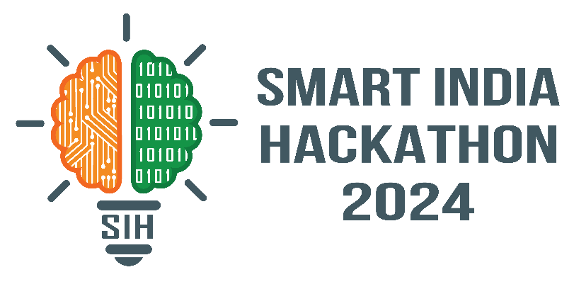
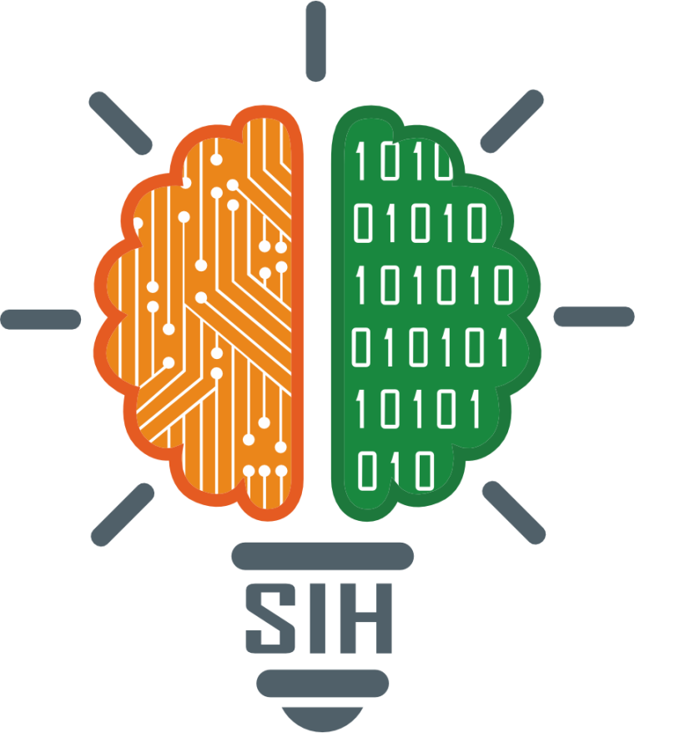
SMART INDIA HACKATHON 2024
Problem Statement ID –1604
Problem Statement Title-Conversational Image Recognition Chatbot
Theme-Smart Automation
PS Category- Software
Team ID-
Team Name-Algo Rangers

Slide 2
IDEA TITLE
Algo Rangers
Concept: AI chatbot combining image recognition and natural language processing.
Features:
Image Recognition: Identifies objects in user-uploaded images.
NLP: Understands queries and provides relevant responses.
Problem Solved: Enables chatbots to interact using both visual and textual inputs.
Innovation:
Multimodal Interaction: Merges visual analysis with conversational AI.
Adaptive Learning: Improves accuracy over time.

Slide 3
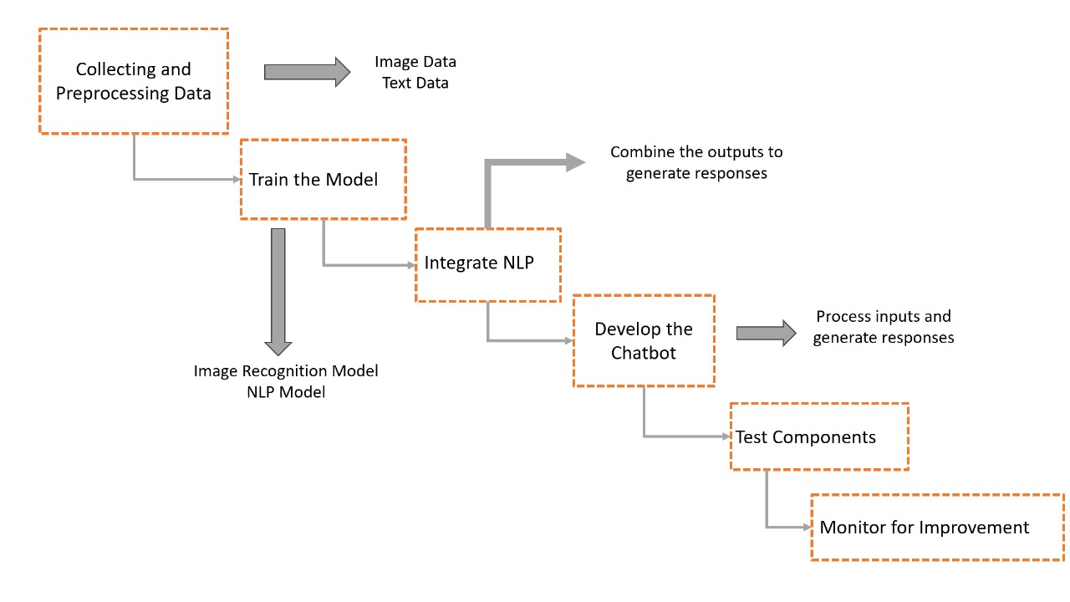
TECHNICAL APPROACH
Algo Rangers
Technologies –
Languages-HTML/CSS,Javascript and Python.
Libraries-YOLOv10,NLP,Django.
Methodologies-
Collecting and preprocessing
Train the model
Integrate NLP
Develop the chatbot
Test Components
Monitor for Improvement.
Flowchart

Slide 4
FEASIBILITY AND VIABILITY
Algo Rangers
Feasibility Analysis
Technical: Feasible with current deep learning technologies.
Resource: Requires significant computational power and storage.
Skills: Needs expertise in machine learning and NLP.
Challenges and Risks
1. Model Accuracy:
Risk: Inaccurate detection and responses.
Strategy: Use advanced models and continuous improvement.
2. Data Quality:
Risk: Poor training data.
Strategy: Collect high-quality datasets and preprocess thoroughly.
3. Integration Complexity:
Risk: Performance issues during integration.
Strategy: Modular design and thorough testing.

Slide 5
IMPACT AND BENEFITS
Algo Rangers
Potential Impact on the Target Audience
Enhanced Experience: More engaging interactions through text and image-based conversations.
Benefits of the Solution
Social:
Better Interaction: Creates more natural and engaging chatbot conversations.
Greater Accessibility: Supports users with visual impairments by providing image descriptions.
Economic:
Cost Efficiency: Lowers customer support costs by automating responses.
Business Growth: Creates new opportunities and boosts chatbot adoption.

Slide 6
RESEARCH AND REFERENCES
Algo Rangers
1. YOLOv8 and Object Detection
- (https://arxiv.org/abs/2004.10934)
-(https://arxiv.org/abs/1804.02767)
2. Natural Language Processing (NLP)
-(https://arxiv.org/abs/1810.04805)
- (https://arxiv.org/abs/1706.03762)
3. Chatbot Frameworks
- (https://arxiv.org/abs/1506.05869)

